Slide 1
DANGEROUS GOODS
28TH AUG 2021

Slide 2

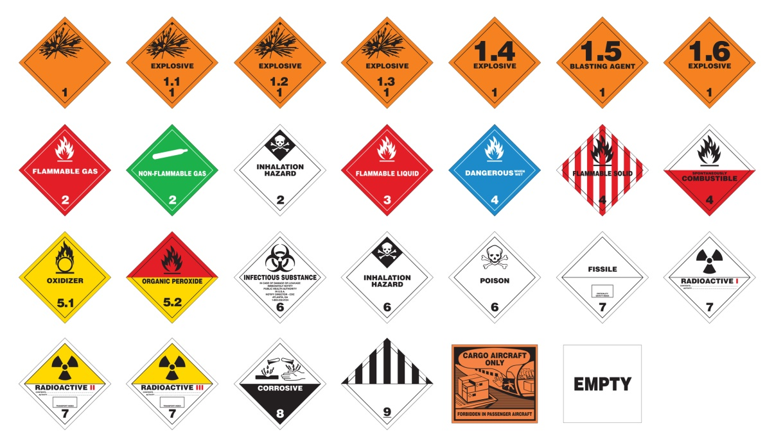

9 CLASSES FOR DG CARGO Which is already discussed in part 1 how many transport modes we have
(1) air (2) sea (3) land

Slide 3



WHAT IS DANGEROUS GOOD ?
Which things we are using on daily basis

Slide 4


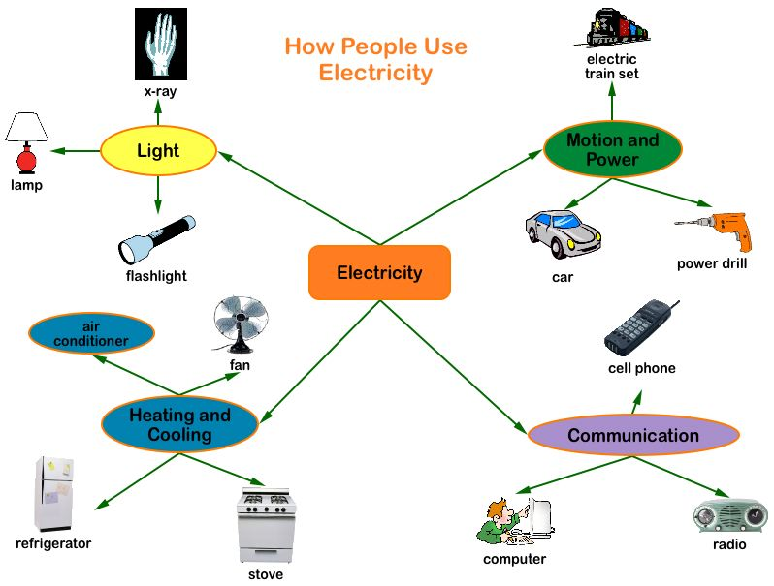



Slide 5

Why we call it dangerous Goods (DG)?
Dangerous goods, abbreviated DG, are substances that when transported are a risk to health, safety,
property or the environment.
That’s why international communities called it DG
* To move this cargo from 1 place to another we have al lot of requirements

Slide 6
Applicability - (shipper and operator responsibilities)
Limitations - (forbidden and hidden goods, storage and transport quantities, transport by post, transport by passengers/crew)
Classification - (explosives, gases, flammable, toxic, oxidizing, radioactive corrosive and multiple hazard material)
Packing Instructions - ( DG cargo & High danger and low danger)
Packaging Specifications - (inner, UN, construction and testing, limited quantity)
Documentation - (shipper’s declaration, air waybill)
Handling - (storage, loading, inspection, information provision.)

Slide 7
shipper and operator responsibilities
A shipper must comply with the current regulations and must ensure that all documentary requirements are followed and that the packaging meets the requirements for shipment by air and sea. The shipper is also responsible for ensuring that maximum net quantities of the dangerous substances are not exceeded.
Hidden dangerous goods storage and transport quantities
Cargo declared under a general description may contain hazardous articles that not apparent.
In absence of proper classification, marking and labeling it becomes very difficult to identify there goods.
Such items can be too dangerous for the safety of flight and occupants.
Hidden dangerous goods are found in many items which are declared under generic description
such as automobile parts, medicines, households etc

Slide 8
Excepted Quantities
Very small quantities of dangerous in certain classes varfing from a minimum of 1gm/ml to
a maximum of 1kg/L Can safely be transported under this provision.
Transport by Post
The universal postal union convention forbids the carriage of dangerous goods
in mail expect for:
Some infectious substances, with dry ice as coolant.
Some patient specimens
Radioactive material having very low activity
Lithium Lon
Lithium metal.

Slide 9
Transport by passenger flights
In the shipping of dangerous goods by air are included:
Explosives;
Gases;
Flammable liquids and solids;
Corrosive substances;
Oxidizing substances and organic peroxides;
Toxic and infectious substances;
Radioactive material with low activity.
Corrosives;
Magnetized materials and miscellaneous dangerous goods.

Slide 10
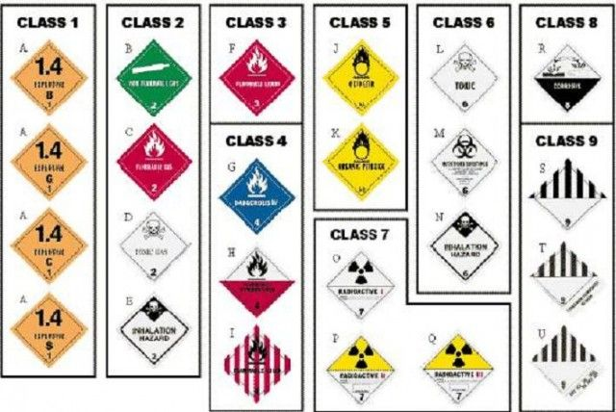
Classification
explosives, gases, flammable, toxic, oxidizing, radioactive and corrosive and multiple hazard material

Slide 11
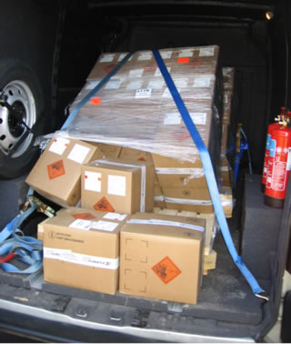
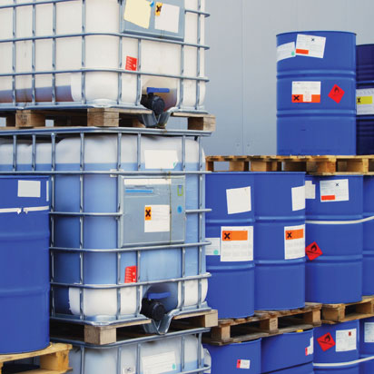
Packing Instructions
Dangerous goods, abbreviated DG, are substances that when transported are a risk to health, safety,
property or the environment. Certain dangerous goods that pose risks even when not being transported
are known as hazardous materials (abbreviated as HAZMAT )

Slide 12



Packaging Specifications
PACKING GROUPS (PGs) Dangerous goods other than Classes 1, 2 and 7, Divisions 5.2
6.2 and some self-reactive substances of Division 4.1, for packaging purposes, have been placed into three
categories depending on the degree of danger they present.
This can also determine the standard of packaging.
Some UN Numbers in DG Code, share more than one Packing Group.
It is important to note that the Safety Data Sheet under section 14 Transport Information,
outlines which Packing Group is associated to the proportion of chemical they have
added to the particular product. Safety Data Sheets will be explained in more detail further on in the course.
Packing group.
I High danger Packing group ( 4A/X500/S/14/GB/AB123)
II Medium danger Packing group ( 4A/Y100/S/14/GB/AB123)
III Low danger ( 4A/Z30/S/14/GB/AB123)
Example
I
II
III

Slide 13
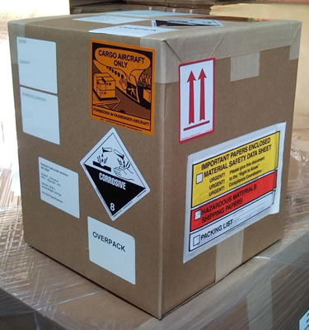
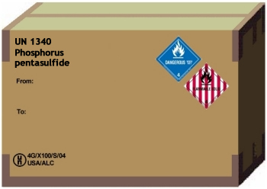
Proper packing

Slide 14
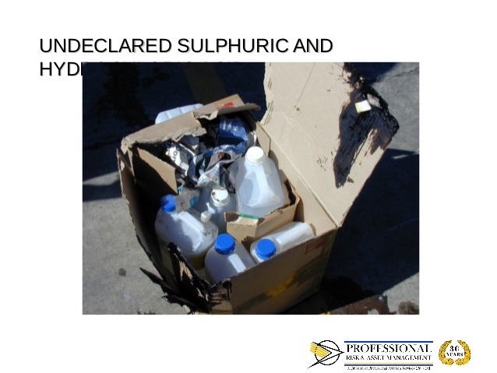
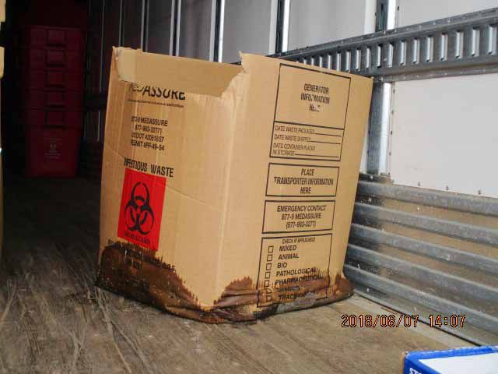
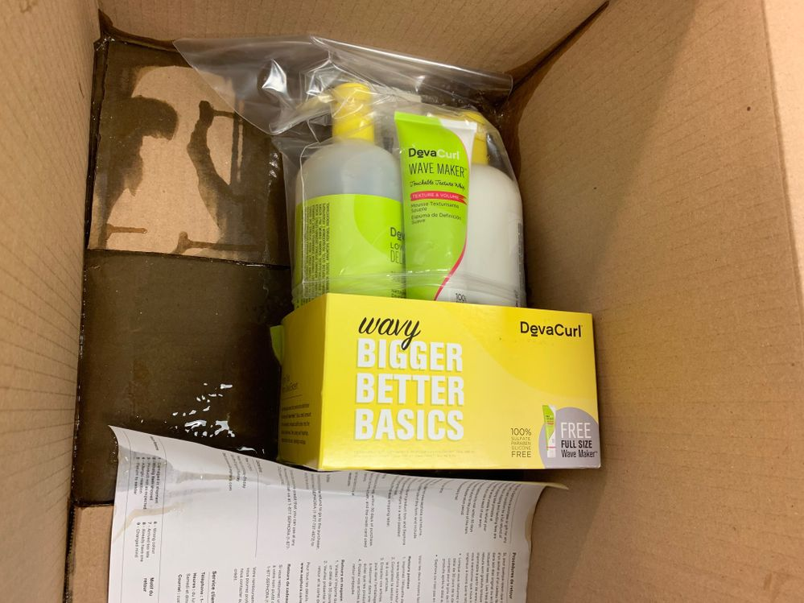
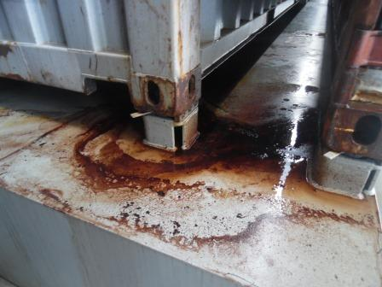
Not Proper Packing

Slide 15
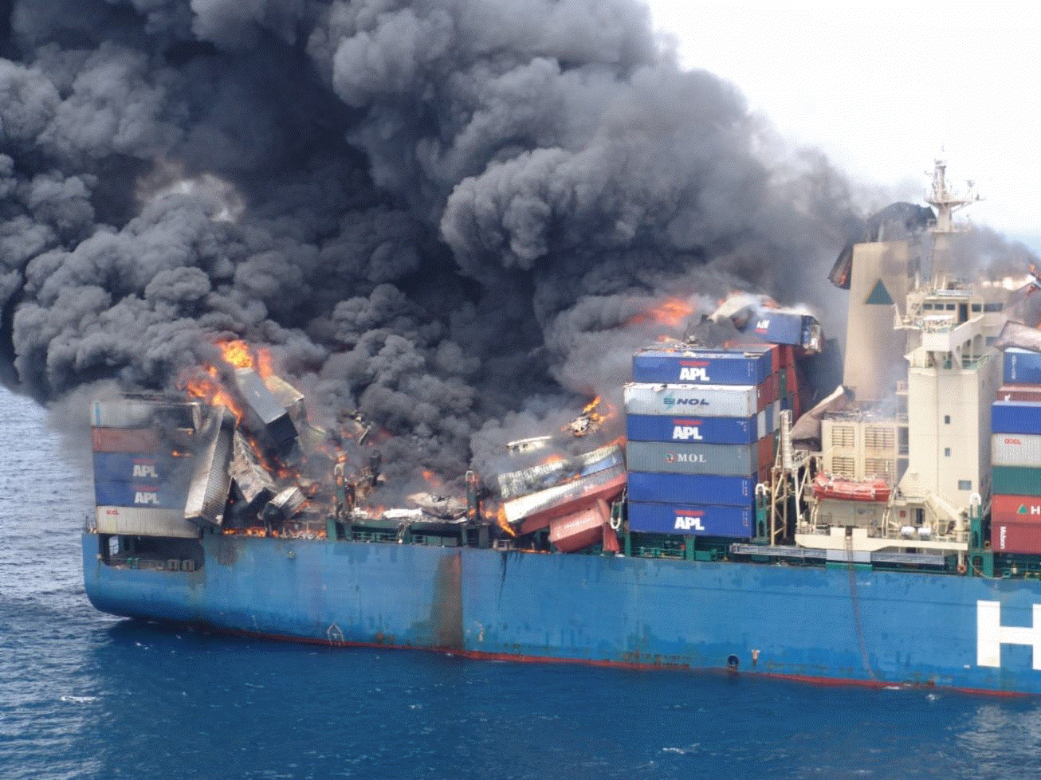
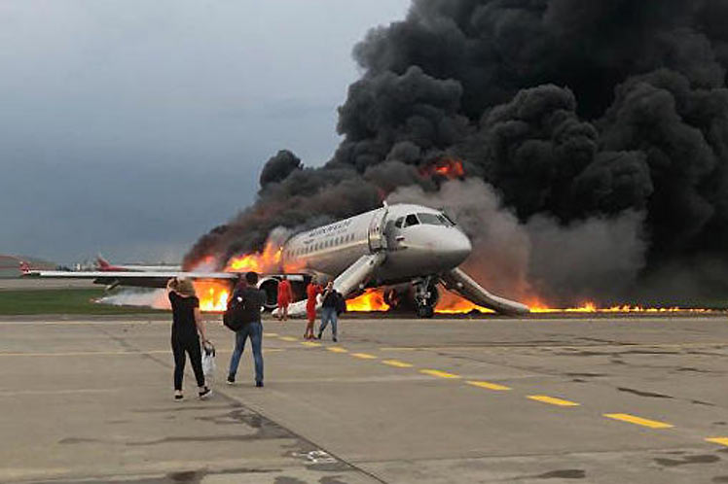
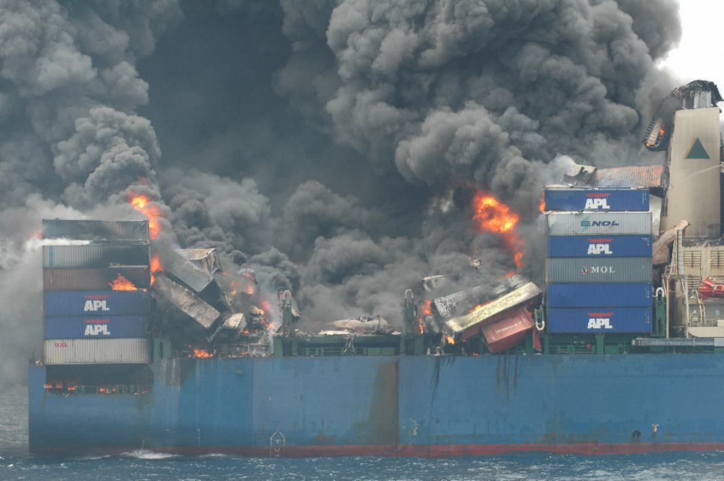
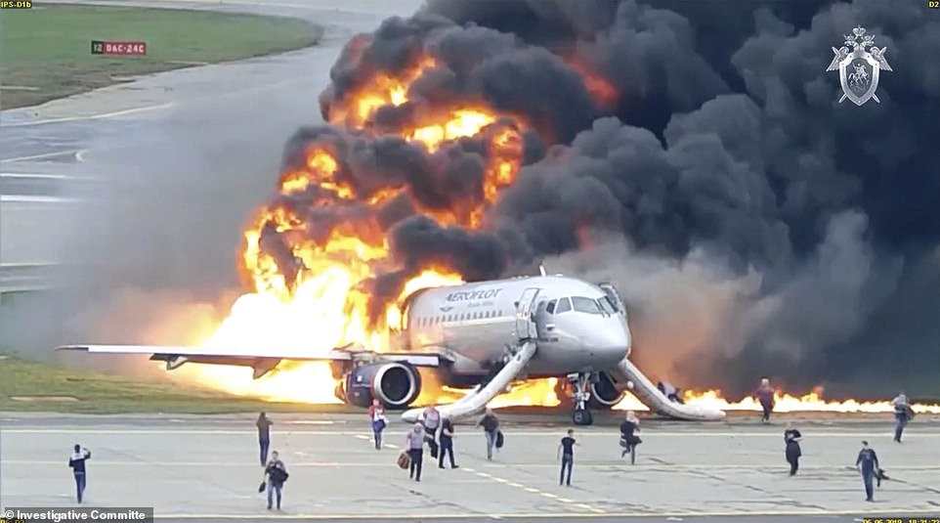

Slide 16
Packaging Specifications - (inner, UN, construction and testing, limited quantity)
Some UN Numbers in DG Code, share more than one Packing Group.
It is important to note that the Safety Data Sheet under section 14 Transport Information,
outlines which Packing Group is associated to the proportion of chemical they have

Slide 17
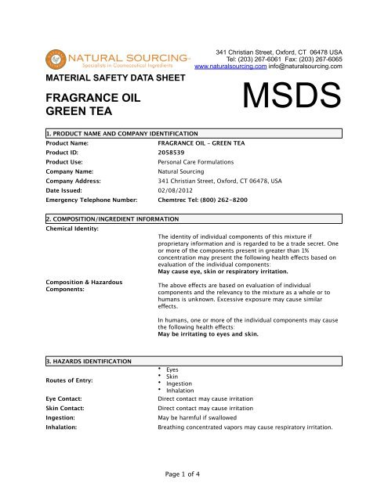
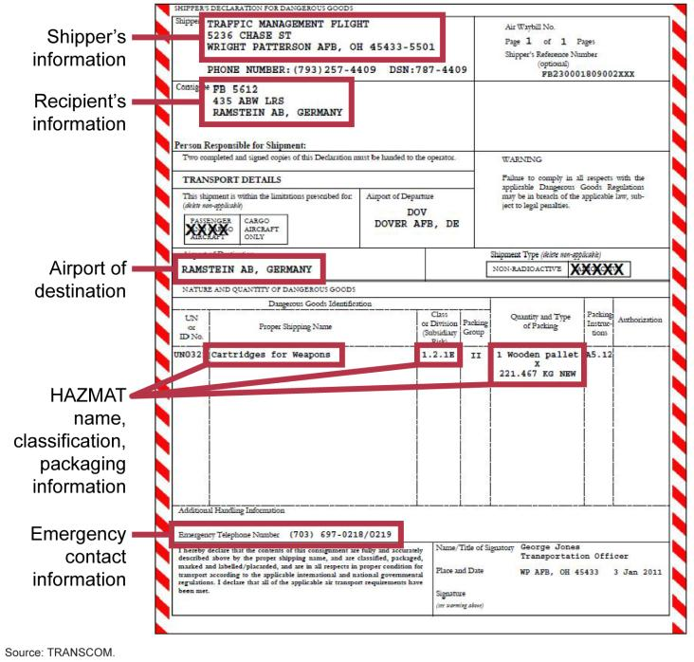
Documentation - (shipper’s declaration, air waybill)

Slide 18

For Documentation Handing
BOOKING
IDG
MSDS
INVOICE
PACKING LIST
NOT RESTRICTED LETTER
DG HANDLER CERTIFICATE NO.
DG STICKERS

Slide 19
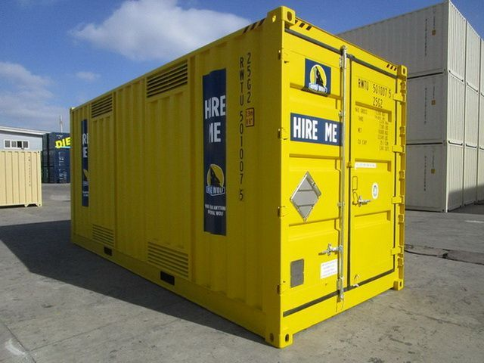
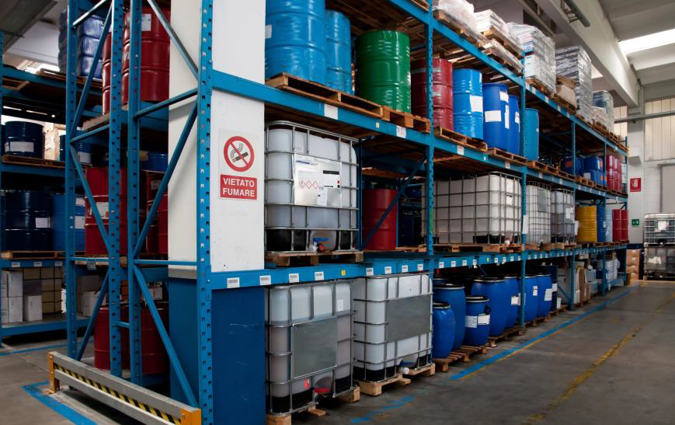
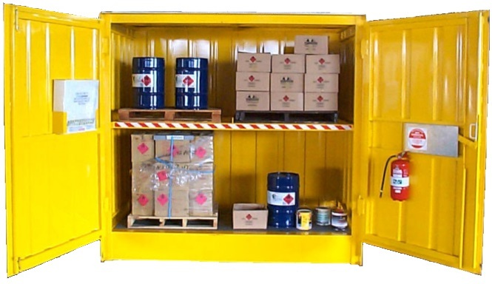
Handling - (storage, Transportation, loading, inspection, information )
DG Cargo of any type, Fuel, Oil, Lubricants, Grease, Paints, Thinner, Perfumery Products and Gases are not permitted for storing and handling in Pre-Built warehouse or Light Industrial Units. However, the same can be stored/handled/manufactured at building/facility constructed at plot of land. Prior to construction, Risk Assessment Study report from the EHS-Trakhees- PCFC(Ports, Customs and Free zone Corporation) pre-qualified RA Consultant shall be carried out with prior approval of scope of work and submitted to EHS-TrakheesPCFC for the review/approval.
Customs clearance need to be prepare in advance and pick up container / cargo with a short limit

Slide 20
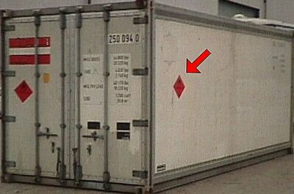
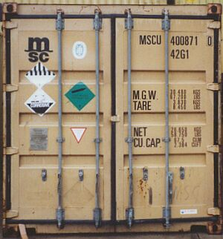
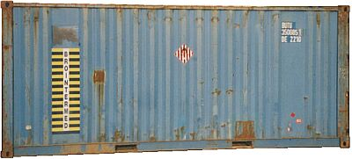
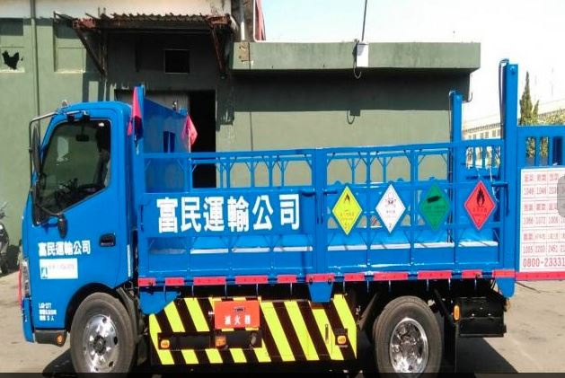
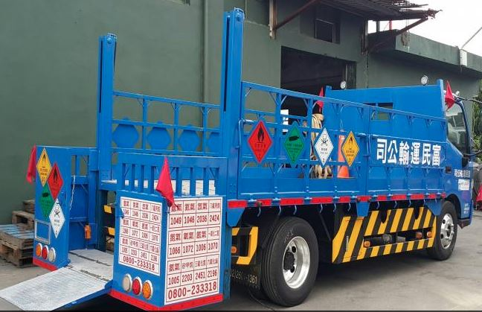
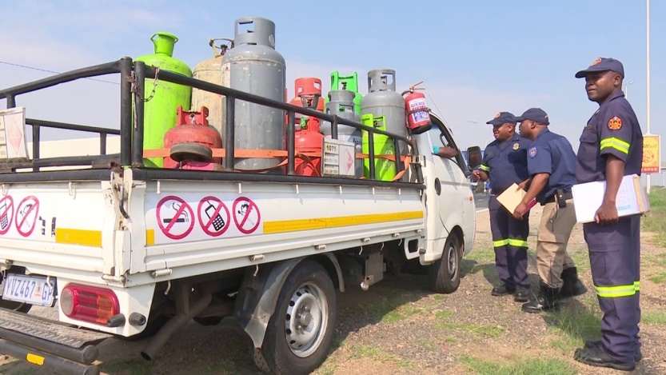
Transportation
transportation of hazardous materials. Its purpose is to "protect against the risks to life, property, and the environment that are inherent in the transportation of hazardous material Each person who offers transportation of hazardous materials must describe the material on accompanied shipping papers. The papers must include—
1 an identification number
2 a proper shipping name, identified in the Hazardous 3 Materials Table
4 the hazard class
5 the packing group, identified in Roman numerals
6 the total quantity of hazardous materials
7 the number and type of packages holding the hazardous contents

Slide 21
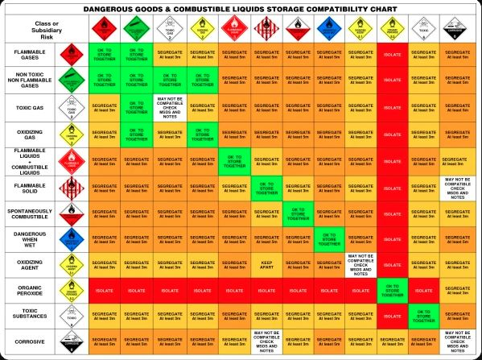
Storage

Slide 22
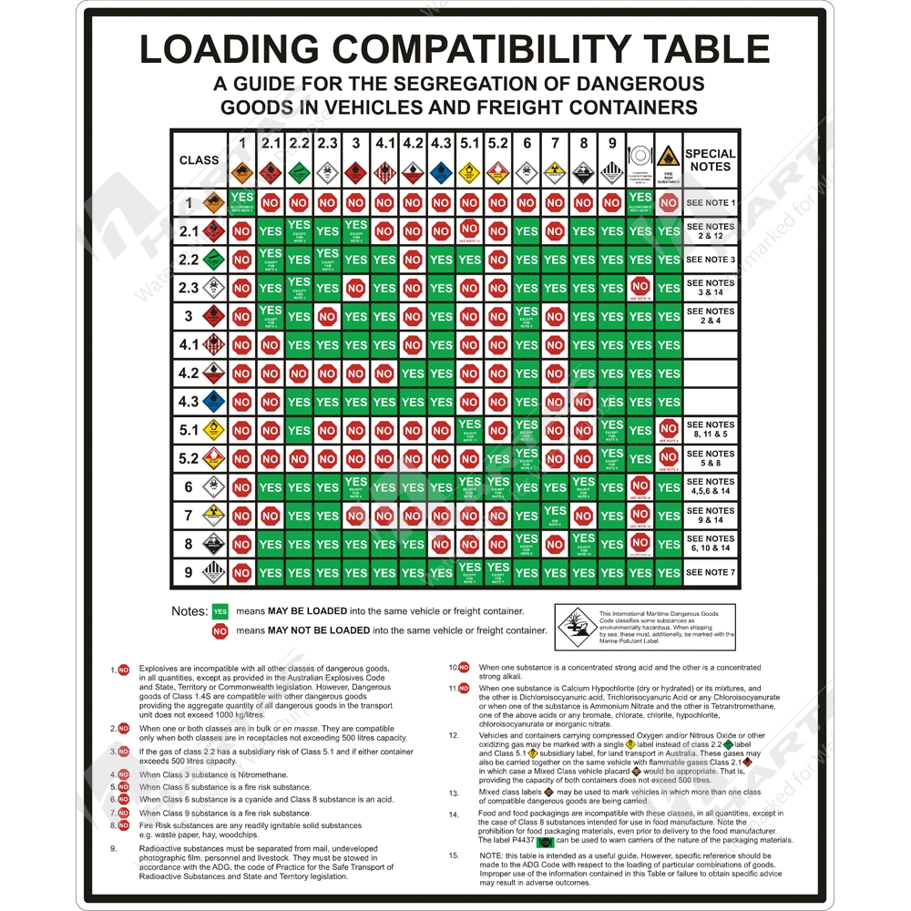
Loading

Slide 23


Slide 24
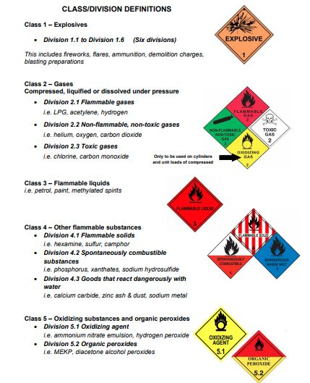

Slide 25
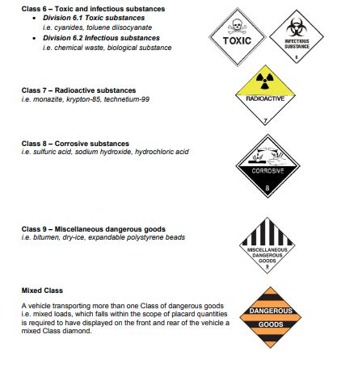

Slide 26

FROM STAR OCEAN OPERATION TEAM

